Slide 1

Introduction to Machine Learning in Python
Missy Tracy
Salt Lake PyLadies
August 29, 2018
Download examples:
https://github.com/missytracy/intro_to_machine_learning

Slide 2
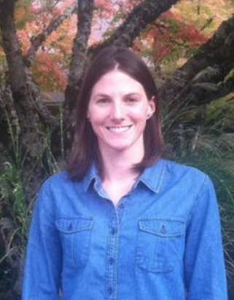
About Me
Biologist → Environmental Engineer → Data Scientist
Recreational machine learning enthusiast (for now)
In your shoes not too long ago
Disclaimer: Not an expert

Slide 3

About You
Interested in machine learning but don’t know much (if anything)
Maybe know some Python
Maybe know some statistics
Excited to learn more
GIF

Slide 4

About Tonight
Definitions and context
Open source tools
Algorithms
Workflow
Examples
Image

Slide 5
About Tonight
Definitions and context
Open source tools
Algorithms
Workflow
Examples
Beginner friendly, ask questions!
Image

Slide 6
What is Machine Learning?

Slide 7
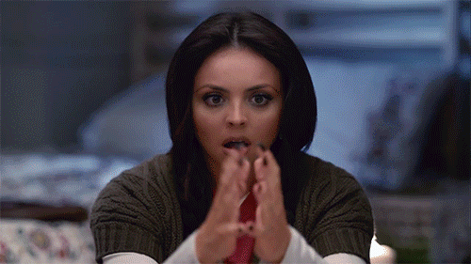
#magic
GIF

Slide 8
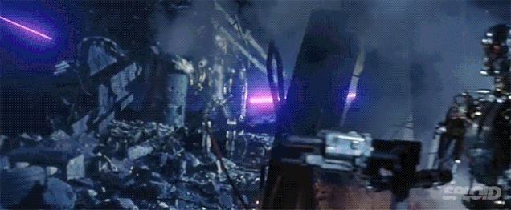
#robot takeover
GIF

Slide 9
What (really) is Machine Learning?

Slide 10
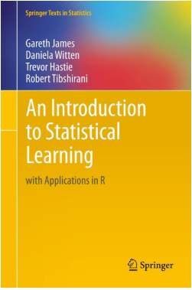
What (really) is Machine Learning?
Definitions from the web:
Wikipedia: Use of statistical techniques to give computers the ability to learn with data without being explicitly programmed.
Gareth et. al: Statistical learning is a vast set of tools for understanding data (fantastic free ebook btw)

Slide 11
What (really) is Machine Learning?
Statistical-based set of rules (aka algorithm)
+
Data
=
Automated pattern recognition

Slide 12
Types of Machine Learning
Supervised - labeled output
Unsupervised - no labels
Image

Slide 13
Example: Supervised Learning Classification
Classification:
Predict customer churn
customerID | gender | tenure | PhoneService | InternetService | .. | Churn
7590-VHGS | Female | 2 | Yes | Yes | .. | Yes
9238-KIOL | Male | 1 | No | Yes | .. | Yes
6399-GRSJ | Male | 13 | No | No | .. | No

Slide 14
Example: Supervised Learning Classification
Classification:
Predict customer churn
Input variables / features
customerID | gender | tenure | PhoneService | InternetService | .. | Churn
7590-VHGS | Female | 2 | Yes | Yes | .. | Yes
9238-KIOL | Male | 1 | No | Yes | .. | Yes
6399-GRSJ | Male | 13 | No | No | .. | No

Slide 15
Example: Supervised Learning Classification
Classification:
Predict customer churn
Labeled Output
(discrete classes)
customerID | gender | tenure | PhoneService | InternetService | .. | Churn
7590-VHGS | Female | 2 | Yes | Yes | .. | Yes
9238-KIOL | Male | 1 | No | Yes | .. | Yes
6399-GRSJ | Male | 13 | No | No | .. | No

Slide 16
Example: Supervised Learning Regression
Regression:
Predict house prices
Neighborhood | bedrooms | bathrooms | SqFt | LotSize | .. | SalePrice
Liberty Wells | 2 | 1 | 900 | 6500 | .. | 326,500
Avenues | 3 | 2 | 1250 | 4500 | .. | 454,000
Downtown | 2 | 1.5 | 800 | 3000 | .. | 389,900

Slide 17
Example: Supervised Learning Regression
Regression:
Predict house prices
Input variables / features
Neighborhood | bedrooms | bathrooms | SqFt | LotSize | .. | SalePrice
Liberty Wells | 2 | 1 | 900 | 6500 | .. | 326,500
Avenues | 3 | 2 | 1250 | 4500 | .. | 454,000
Downtown | 2 | 1.5 | 800 | 3000 | .. | 389,900

Slide 18
Example: Supervised Learning Regression
Regression:
Predict house prices
Labeled Output
(continuous values)
Neighborhood | bedrooms | bathrooms | SqFt | LotSize | .. | SalePrice
Liberty Wells | 2 | 1 | 900 | 6500 | .. | 326,500
Avenues | 3 | 2 | 1250 | 4500 | .. | 454,000
Downtown | 2 | 1.5 | 800 | 3000 | .. | 389,900

Slide 19
Example: Unsupervised Learning Clustering
Clustering:
Customer segmentation
InvoiceID | StockCode | Quantity | InvoiceDate | UnitPrice | .. | CustomerID
AE458 | 115 | 10 | 9/12/2017 08:05 | 2.59 | .. | 59210
GR478 | 109 | 1 | 9/12/2017 12:15 | 18.50 | .. | 78455
FR951 | 102 | 2 | 9/13/2017 15:11 | 54.99 | .. | 26826

Slide 20
Example: Unsupervised Learning Clustering
Clustering:
Customer segmentation
Input variables / features
InvoiceID | StockCode | Quantity | InvoiceDate | UnitPrice | .. | CustomerID
AE458 | 115 | 10 | 9/12/2017 08:05 | 2.59 | .. | 59210
GR478 | 109 | 1 | 9/12/2017 12:15 | 18.50 | .. | 78455
FR951 | 102 | 2 | 9/13/2017 15:11 | 54.99 | .. | 26826

Slide 21
Example: Unsupervised Learning Clustering
Clustering:
Customer segmentation
No labels!
InvoiceID | StockCode | Quantity | InvoiceDate | UnitPrice | .. | CustomerID
AE458 | 115 | 10 | 9/12/2017 08:05 | 2.59 | .. | 59210
GR478 | 109 | 1 | 9/12/2017 12:15 | 18.50 | .. | 78455
FR951 | 102 | 2 | 9/13/2017 15:11 | 54.99 | .. | 26826

Slide 22
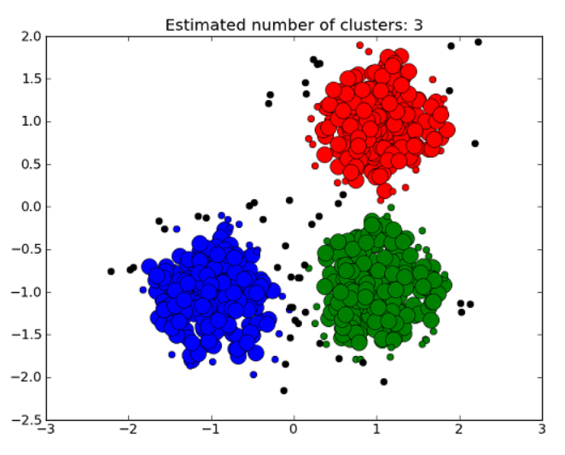
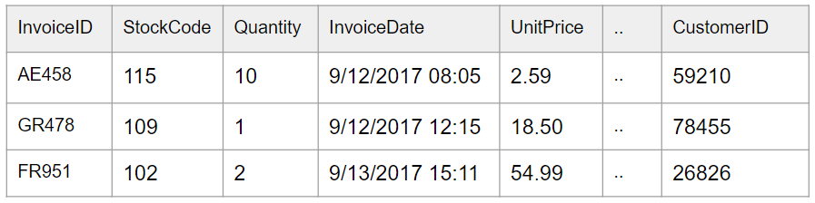
Example: Unsupervised Learning Clustering
Clustering:
Customer segmentation
Image

Slide 23
Open Source Python Tools

Slide 24
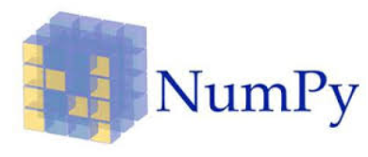
NumPy
Scientific Computing:
N-dimensional array object
Sophisticated functions
Linear algebra, Fourier transforms
Random number capabilities

Slide 25
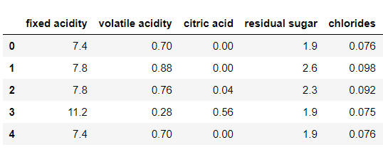
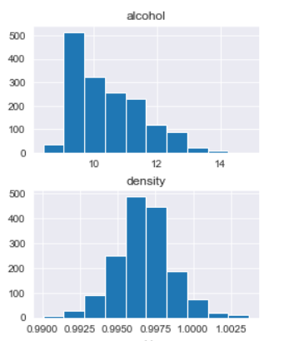
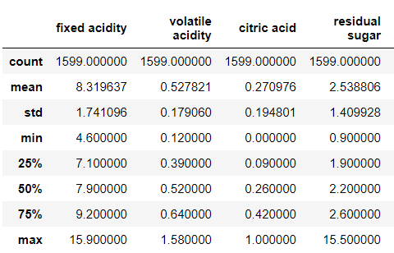
Pandas
Data manipulation and analysis
Tabular structure (think Microsoft Excel)
Reading and writing data
Data preparation
Basic statistics
Basis plotting
Group by function
Merging/Joins
The list goes on….

Slide 26
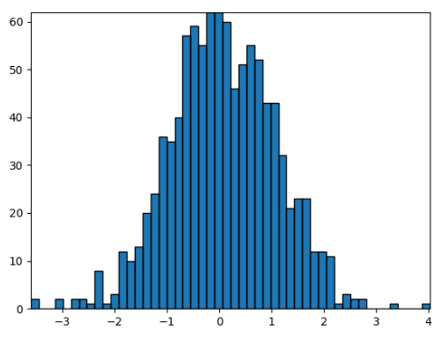
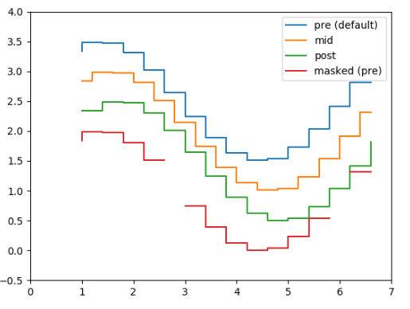
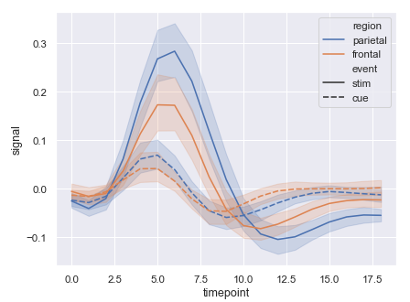
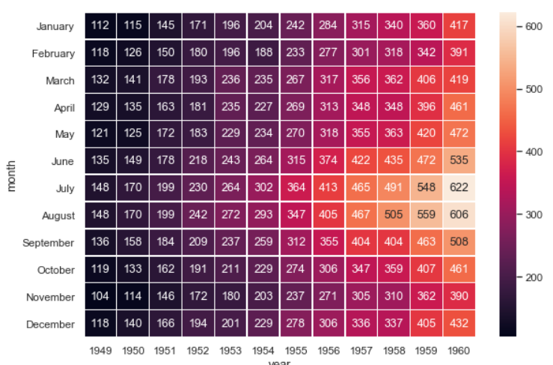
Matplotlib / Seaborn
Matplotlib
Standard visualizations
Seaborn
Based on matplotlib
More sophisticated visualizations
Better formatting
*images from library documentation

Slide 27
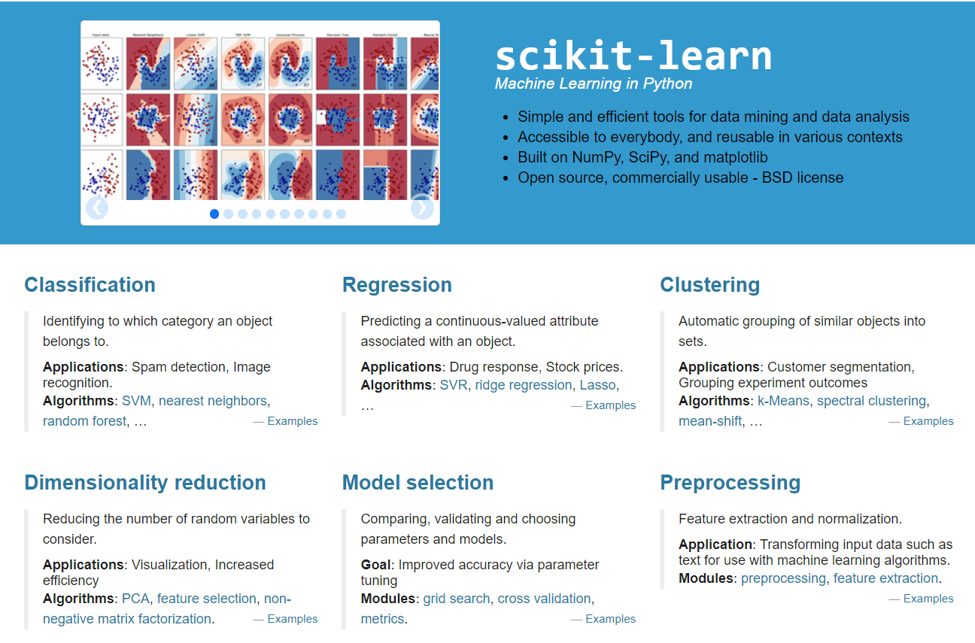
Scikit Learn

Slide 28
Scikit Learn
Image

Slide 29
Scikit Learn
Image

Slide 30
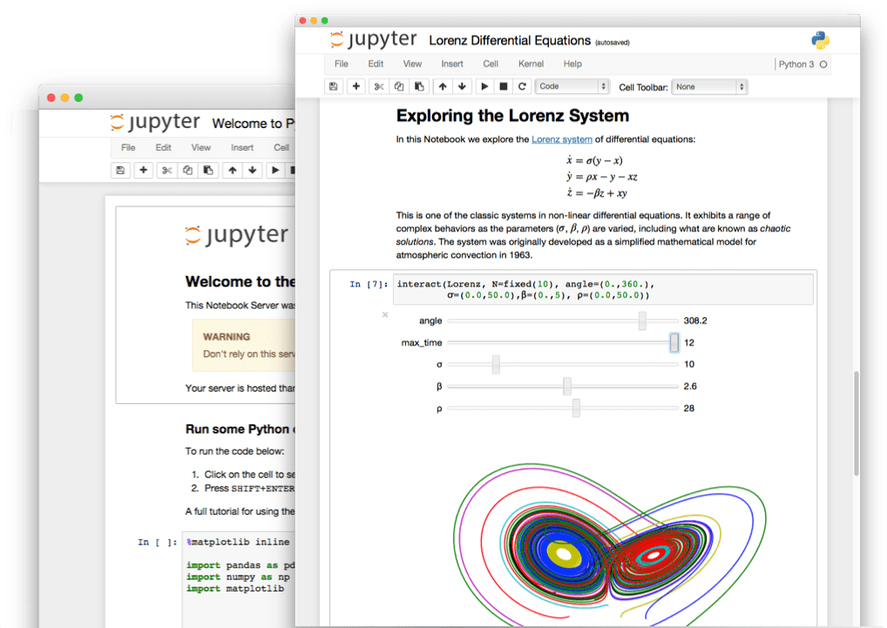

Jupyter Notebook
Web app for interactive computing
Allows code, visualization, and text

Slide 31
Algorithms

Slide 32
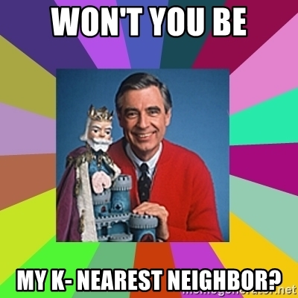
Common Supervised Learning Algorithms
We’ll briefly cover:
Naive Bayes
Linear Regression
Logistic Regression
Decision Trees / Random Forests
K-Nearest Neighbor
Neural Networks
Image

Slide 33
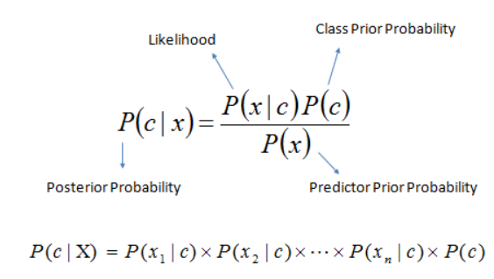
Naive Bayes
Classification only
Based on conditional probability - “Bayes’ Theorem”
“Naive” because it assumes variables are all independent
Quick, simple, but assumption of independence usually wrong
Image

Slide 34
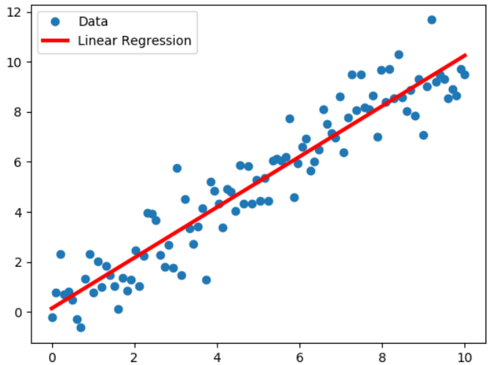
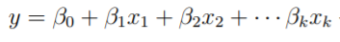
Linear Regression
Regression only
Assumes linear relationship between inputs (x) and output (y)
Simple linear regression (one x)
Multiple linear regression (many x)
Estimate coefficients of each input
Image

Slide 35
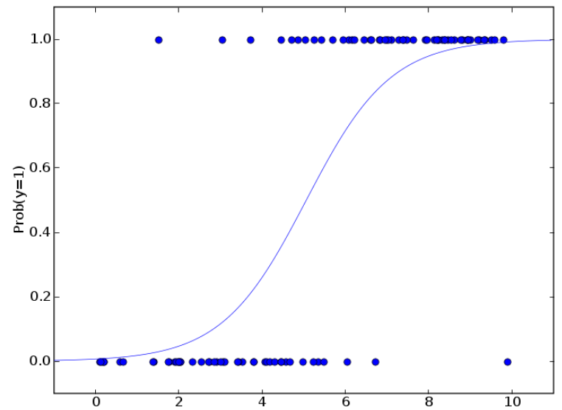
Logistic Regression
Classification only
Less intuitive
Estimates probability of class membership
Output can be a probability (0.0 to 1.0) or class membership
Image

Slide 36
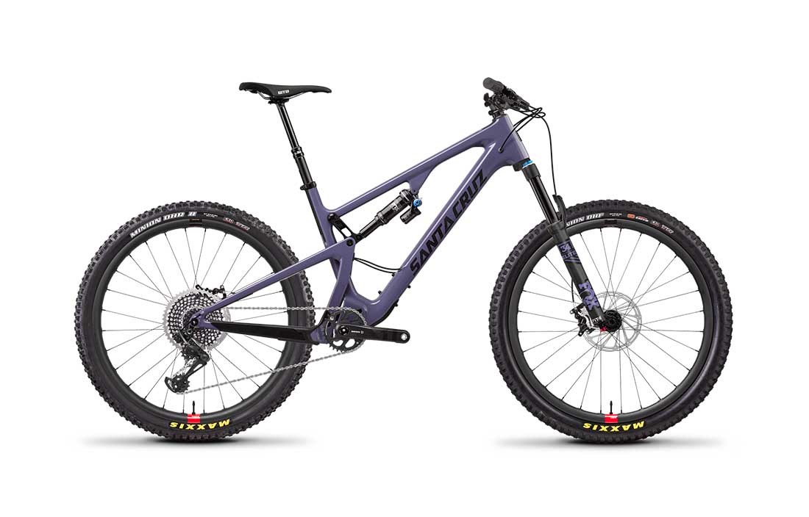
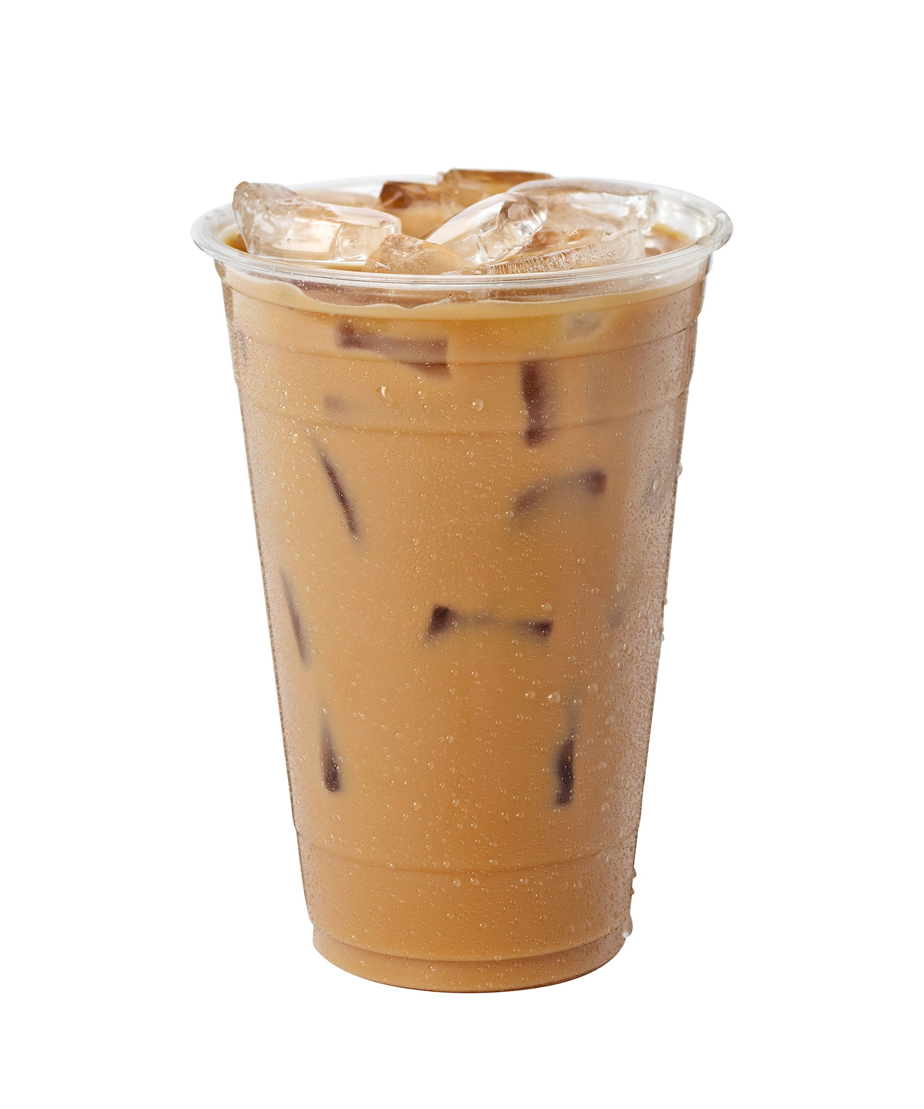

Decision Tree
Coffee or bike?
Classification or regression
Tree-like decision logic
Maximize information gain at each node
Asking the right questions (features)
Is it raining?
No
Yes
Is it really hot?
Light rain?
No
Yes
No
Yes
Bike
Coffee shop
Bike

Slide 37
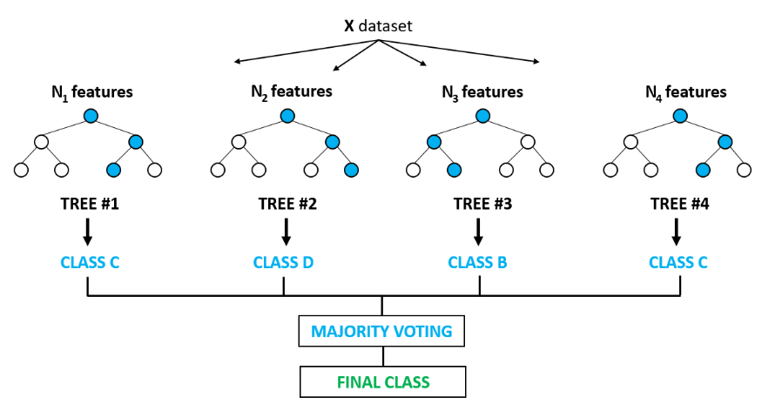
Random Forest
Classification or regression
Collection of decision trees made from subsets of the data
Classification - majority wins
Regression - mean
More robust model
Image

Slide 38
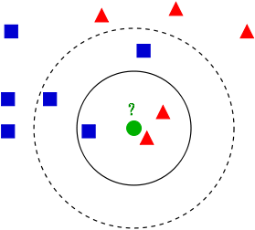
K-Nearest Neighbor
Classification or regression
Similarity model based on neighbors
Closer neighbors can be weighted higher
K = number of neighbors
Image

Slide 39

Neural Networks
Classification or regression
Mimic neurons in the brain
More hidden layers → deep learning
Limited implementation in Sklearn
Better libraries exist:
TensorFlow, Keras, PyTorch
Image

Slide 40

How do I choose?
Image

Slide 41
How do I choose?
Short answer: try several and evaluate performance
Some considerations:
Classification or regression
Care about feature importance?
Yes: Linear regression, logistic regression, decision tree, random forest
No: Naive Bayes, KNN, neural networks
How much data do you have?
Memory constraints?
Production environment?

Slide 42
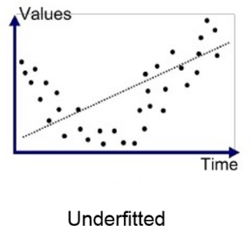
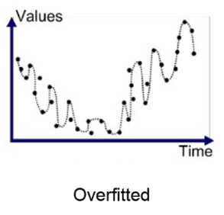
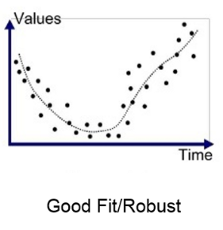
A word on bias-variance tradeoff
Types of error we are trying to minimize
Bias:
Underfit model
Not flexible enough, doesn’t pick up pattern
Variance:
Overfit model
Too flexible, picks up noise
Adjust flexibility through hyperparameter tuning
Avoid overfitting by using testing and training data sets
Image

Slide 43
A word on bias-variance
Types of error we are trying to minimize
Bias:
Underfit model
Not flexible enough, doesn’t pick up pattern
Variance:
Overfit model
Too flexible, picks up noise
Adjust flexibility through hyperparameter tuning
Avoid overfitting by using testing and training data sets
Image

Slide 44
A word on bias-variance
Types of error we are trying to minimize
Bias:
Underfit model
Not flexible enough, doesn’t pick up pattern
Variance:
Overfit model
Too flexible, picks up noise
Adjust flexibility through hyperparameter tuning
Avoid overfitting by using testing and training data sets
Image

Slide 45
A word on bias-variance
Types of error we are trying to minimize
Bias:
Underfit model
Not flexible enough, doesn’t pick up pattern
Variance:
Overfit model
Too flexible, picks up noise
Adjust flexibility through hyperparameter tuning
Avoid overfitting by using testing and training data sets
Image

Slide 46
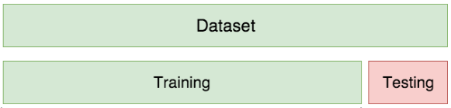
Train/Test Split
Method depends on how much data you have
At a minimum:
Image

Slide 47
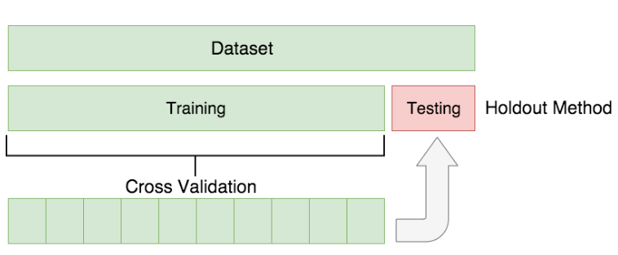
Train/Test Split
Method depends on how much data you have
At a minimum:
Even better:
Training
Iteration 1 | Test
Iteration 2 |  | Test
Iteration 3 |  |  | Test
Iteration 4 |  |  |  | Test
Image

Slide 48
Workflow

Slide 49
Workflow
Data Cleaning and Exploration
Data Preparation
Model Selection
Train and Validate
Test and Predict

Slide 50
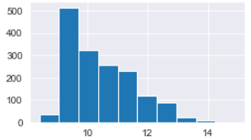
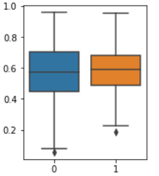
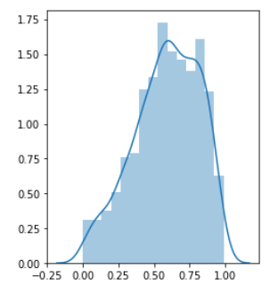
Workflow
Data Cleaning and Exploration
Data Preparation
Model Selection
Train and Validate
Test and Predict
Get to know your data
Summary statistics
Visualizations

Slide 51
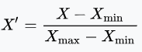
Workflow
Data Cleaning and Exploration
Data Preparation
Model Selection
Train and Validate
Test and Predict
Feature engineering
Train/test split
Preprocessing

Slide 52
Workflow
Data Cleaning and Exploration
Data Preparation
Model Selection
Train and Validate
Test and Predict
Regression or classification
Feature importance
Computational demands

Slide 53
Workflow
Data Cleaning and Exploration
Data Preparation
Model Selection
Train and Validate
Test and Predict
Hyperparameter tuning
Try out several, pick the best
(training data)

Slide 54
Workflow
Data Cleaning and Exploration
Data Preparation
Model Selection
Train and Validate
Test and Predict
How well does the model generalize to unseen data?
(test data)

Slide 55
Iterative Process
Data Cleaning and Exploration.
05
Test and Predict
01
04
Train and Validate
Data Preparation
02
03
Model Selection

Slide 56
Examples

Slide 57
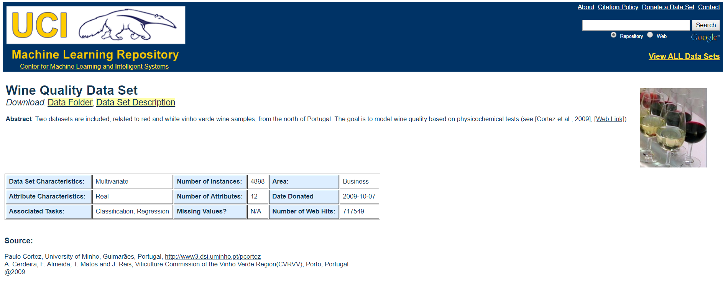
Wine Quality
Classic introductory data set for learning regression and classification

Slide 58
Thank You!
Questions?

